Slide 1


Technical Presentation on
Pradhan Mantri Anusuchit Jaati Abhyuday Yojna
(PM-AJAY)
By
National Informatics Centre
Department of Social Justice and Empowerment,GOI

Slide 2
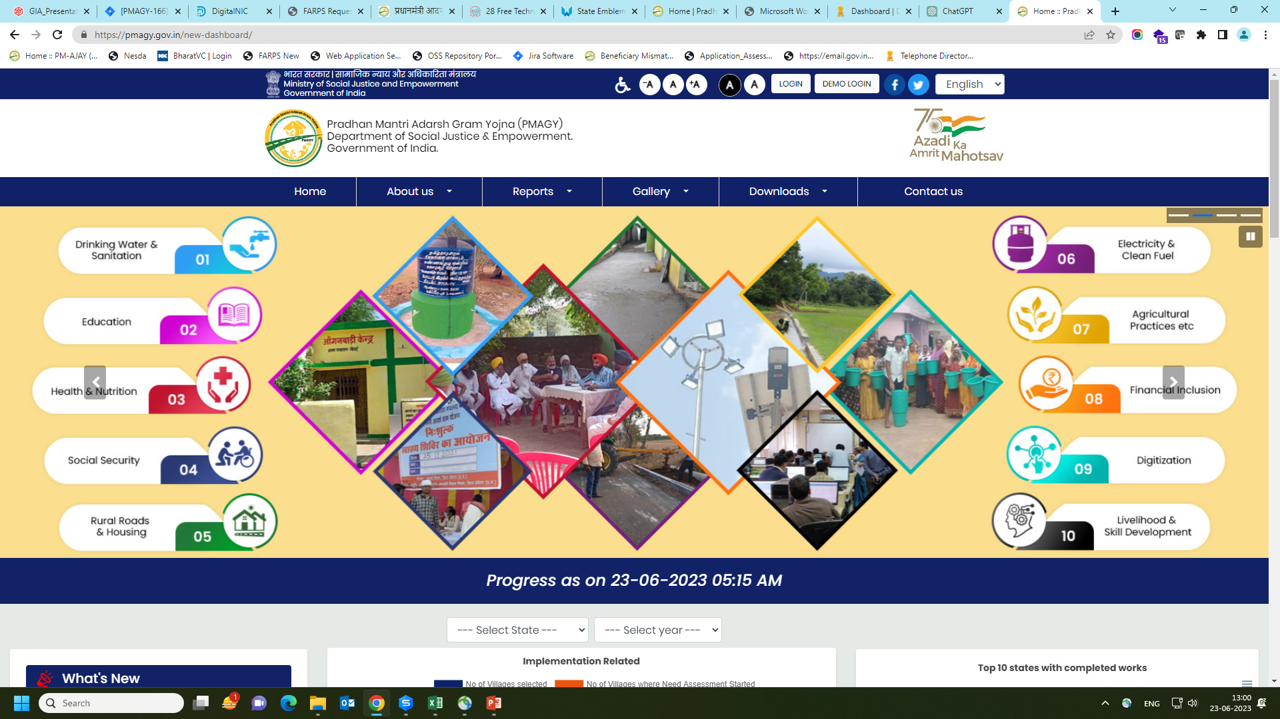
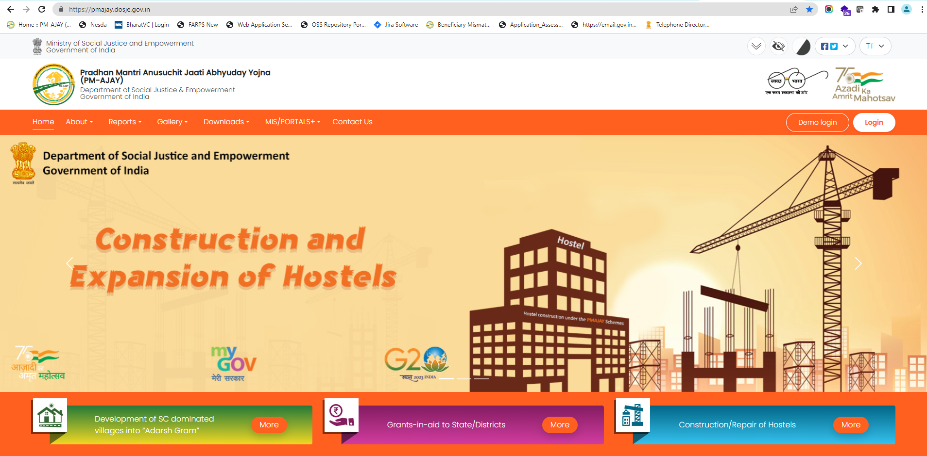
Components
PM-AJAY is a Centrally Sponsored Scheme having three components:
  Development of SC dominated villages into “Adarsh Gram”
  (MIS: https://pmagy.gov.in)
  Grants-in-aid to State/Districts
  Construction/Repair of Hostels (MIS: https://pmajay.dosje.gov.in)
https://pmagy.gov.in
https://pmajay.dosje.gov.in

Slide 3
https://pmajay.dosje.gov.in
The portal caters to the two components of scheme as “Adarsh Gram component” has separate portal (https://pmagy.gov.in).
(i) Grants-in-Aid to States/Districts
(ii) Construction/Repair of Hostels

Slide 4
Grants-in-Aid to States/Districts

Slide 5
Interventions of “Grants-in-Aid to States/Districts”
“Grants-in-Aid to States/Districts” component of PM-AJAY has three interventions
Grants-in-Aid to States/Districts
Skill Development
Income Generation Activity
Infrastructure development
Projects for skill development as per norms prescribed by the Ministry of Skill Development & Entrepreneurship
Comprehensive Livelihood Projects
Development of infrastructure related to the project for common utility purposes

Slide 6
MIS :: Modules of “Grants-in-Aid to States/Districts”
Separate login credentials for States/Districts to create and submit the proposals in single or hybrid projects
Two level approval of proposal by Maker/Checker user
Create and Submit the Single/Hybrid* Project
Each user has privileges to forward/Approve/Reject/Return the project
Manage Executing Agency
Manage Skill Institute
Submit Perspective Plan (PP) to Ministry
Progress Reporting of Projects
Upload the Sanction Order
* Hybrid project contains more than one intervention

Slide 7
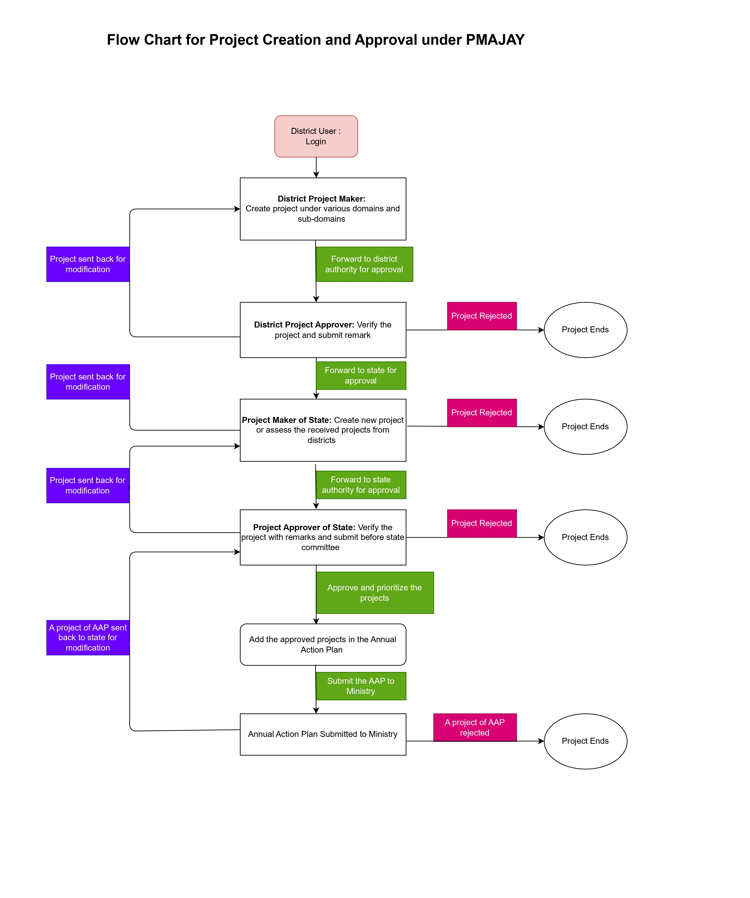
Flow Chart of project movement under Grants-In-Aid

Slide 8
District Maker | District Checker
Create/Edit Skill Institute Create/Edit Executing Agency Create/Edit GIA project Reports | Approve Skill Institute Approve Executing Agency Froward GIA project to state Reports
State Maker | State Checker
Create/Edit Skill Institute Create/Edit Executing Agency Create/Edit GIA project Reports | Approve Skill Institute Approve Executing Agency Approve GIA project to state Submit Perspective Plan of GIA project Reports
Stakeholder wise Modules in GIA

Slide 9
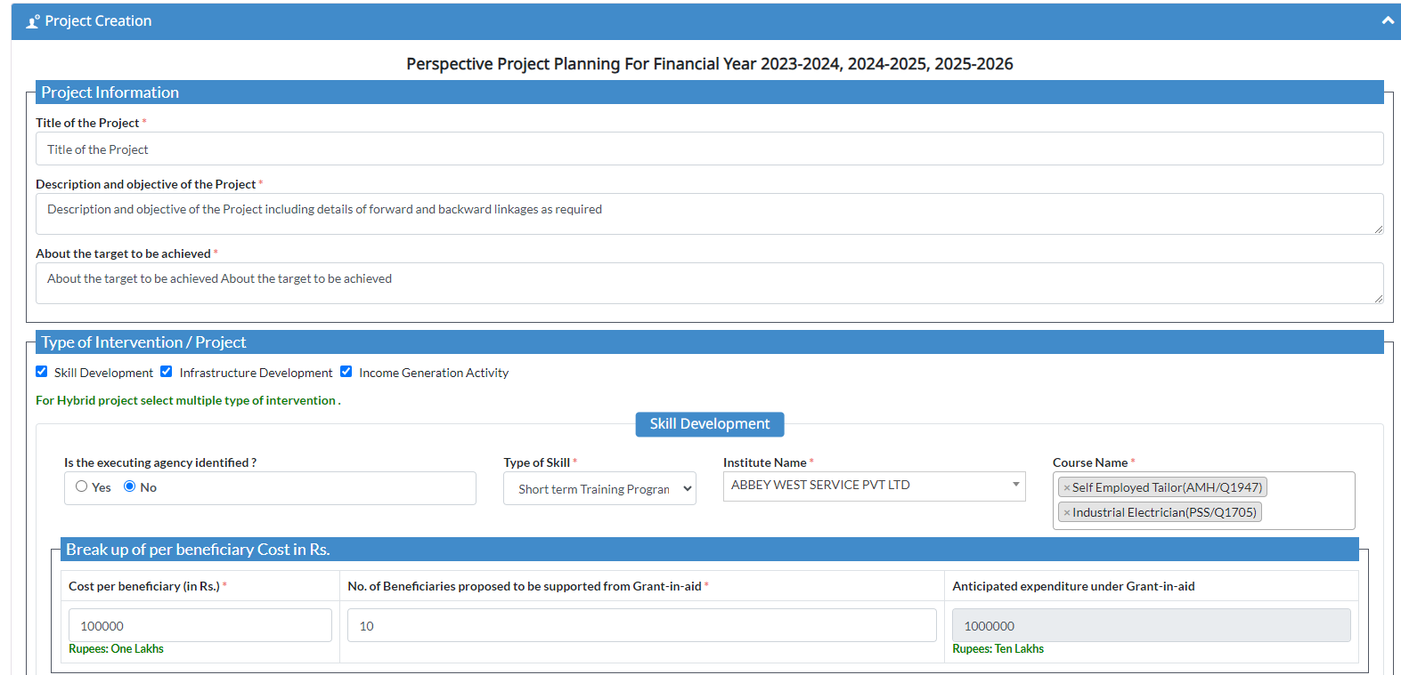
Format to submit the project

Slide 10
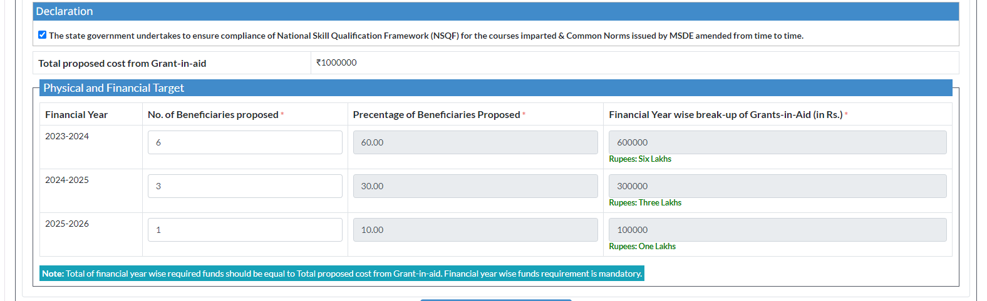
Continued…
Format to submit the project

Slide 11
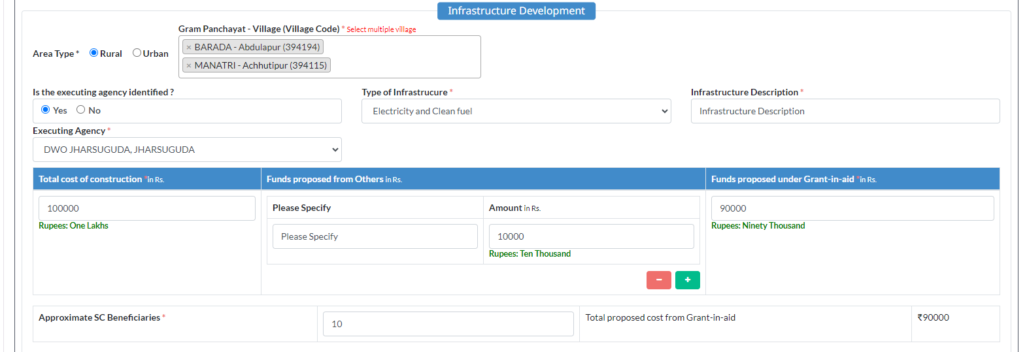
Continued…
Format to submit the project

Slide 12
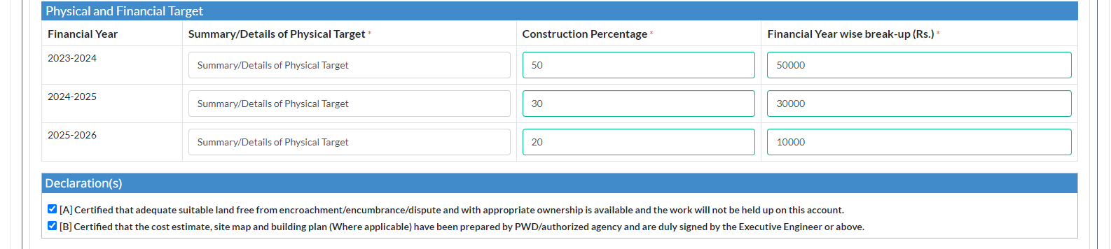
Continued…
Format to submit the project

Slide 13
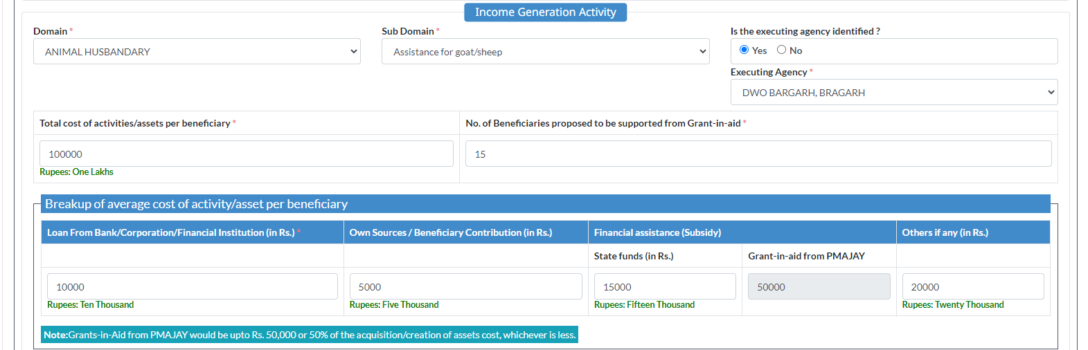
Continued…
Format to submit the project

Slide 14
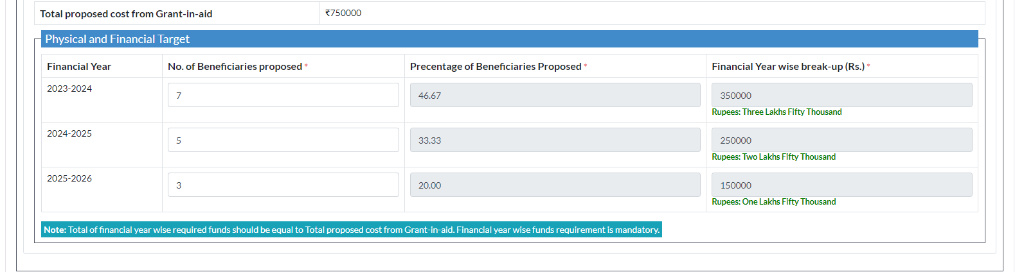
Continued…
Format to submit the project

Slide 15
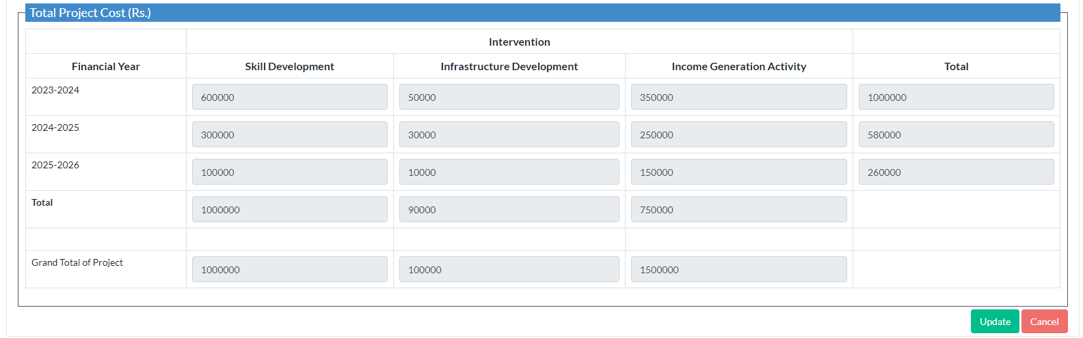
Continued…
Format to submit the project

Slide 16
Online Submission of GIA Projects in 2022-23
States Submitted Perspective Plan
No. of Projects Submitted
No. of Projects Approved Online
7
1211
1211

Slide 17
Construction / Repair of Hostels

Slide 18
Online Proposals under “Construction/Repair of Hostels”
Five categories of proposals are accepted under the Hostel component
Construction/Repair of Hostels
Add Already Sanctioned Hostel
Release of 2nd Installment
One Time Grant
Expansion of Existing Hostel
Repair and Maintenance of Hostel
New Hostel Construction

Slide 19
MIS :: Modules of “Construction/Repair of Hostels”
Following are the modules available on PM-AJAY portal:
Registration of State/Central Level Institute/University by Ministry
Separate login-credentials for State Dept., District,
State Level Institute & Central Level Institute/University
Submission of Hostel related proposals
Submission of Already Sanctioned Hostel (Legacy)
Forward/Approve/Reject/Return the hostel proposal
Progress submission of respective proposal

Slide 20
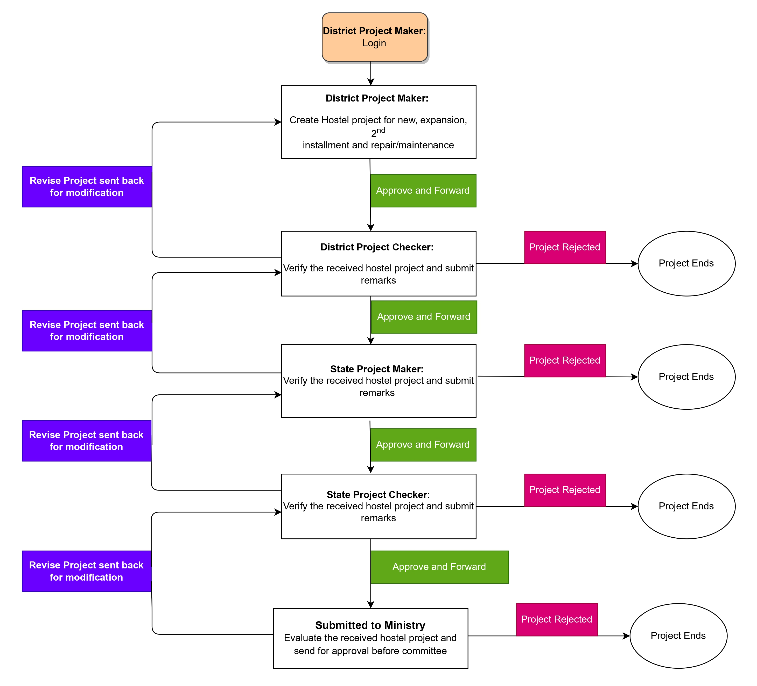
Flow Chart of hostel proposal movement from district

Slide 21
District/State - Maker | District/State - Checker
Create Add Already Sanctioned Hostel Create/Edit New Hostel Proposal Create/Edit Expansion of Existing Hostel Create/Edit Repair Hostel Create/Edit One Time Grant Create/Edit 2nd Installment Hostel Submit Progress Reports | Approve New Hostel Proposal Approve Expansion of Existing Hostel Approve Repair Hostel Approve One Time Grant Approve 2nd Installment Hostel Reports
State Institute/State University - Maker | State Department - Checker
Create Add Already Sanctioned Hostel Create/Edit New Hostel Proposal Create/Edit Expansion of Existing Hostel Create/Edit Repair Hostel Create/Edit One Time Grant Create/Edit 2nd Installment Hostel Submit Progress Reports | Approve New Hostel Proposal Approve Expansion of Existing Hostel Approve Repair Hostel Approve One Time Grant Approve 2nd Installment Hostel Reports
Stakeholder wise Modules in Hostel

Slide 22
Central Institute/Central University - Maker | Ministry
Create Add Already Sanctioned Hostel Create/Edit New Hostel Proposal Create/Edit Expansion of Existing Hostel Create/Edit Repair Hostel Create/Edit One Time Grant Create/Edit 2nd Installment Hostel Submit Progress Reports | Approve New Hostel Proposal Approve Expansion of Existing Hostel Approve Repair Hostel Approve One Time Grant Approve 2nd Installment Hostel Reports
Stakeholder wise Modules in Hostel

Slide 23
Required documents to submit the Hostel Proposal

Slide 24
Document Details before Submit the Hostel Proposal

Slide 25
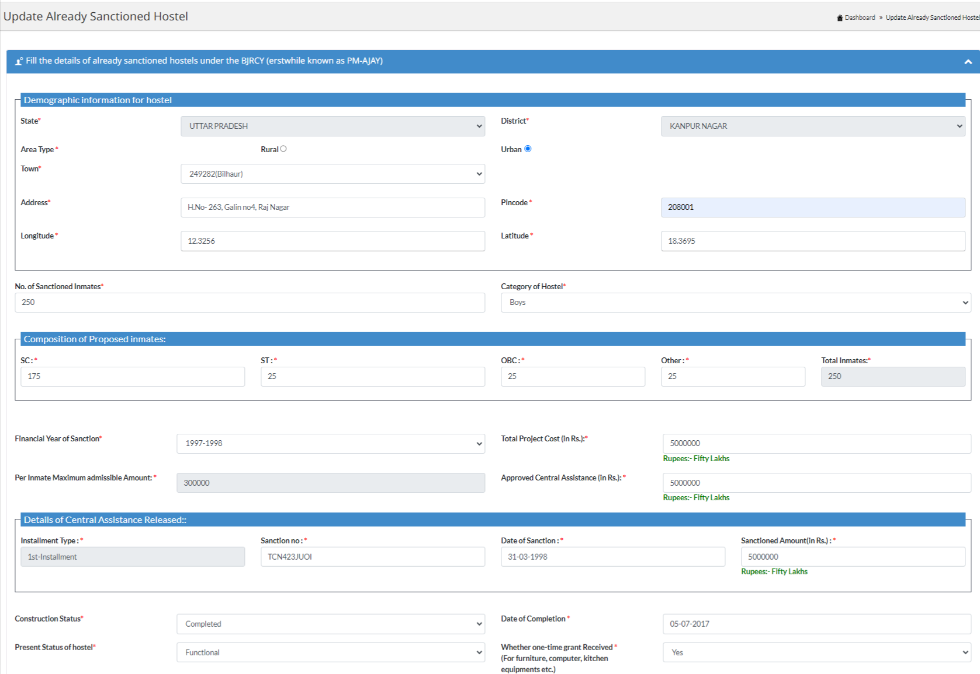
Format to submit the proposal of Sanctioned hostel

Slide 26
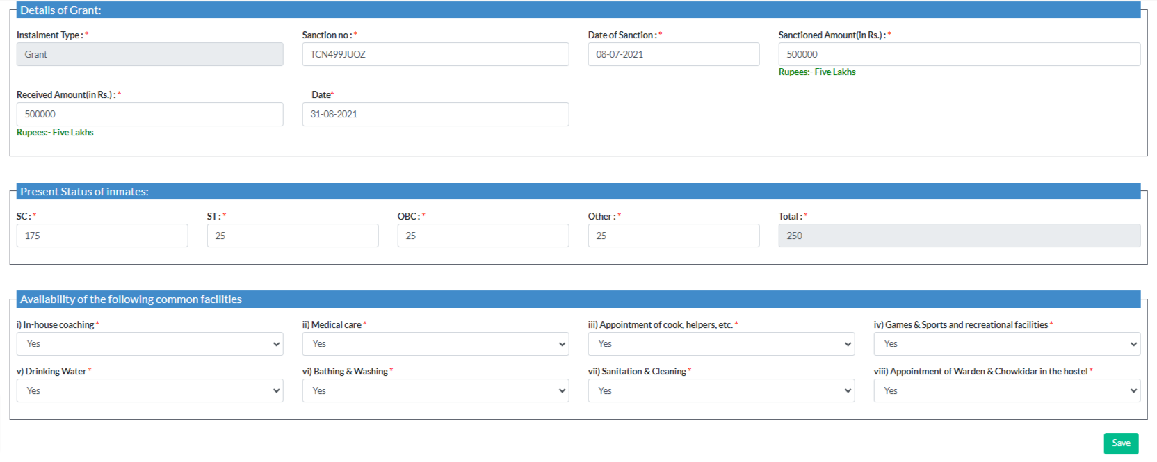
Continued…
Format to submit the proposal of Sanctioned hostel

Slide 27
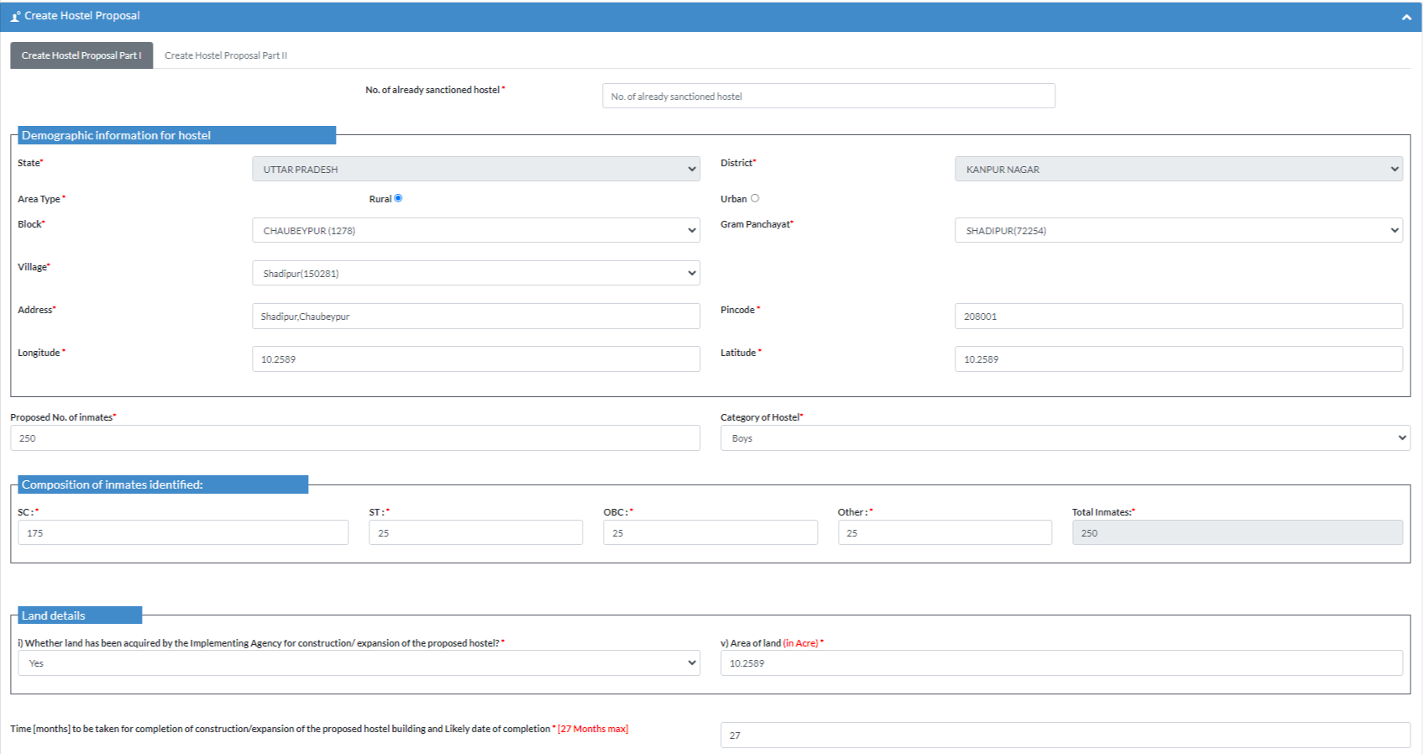
Format to submit the proposal of hostel Part 1

Slide 28
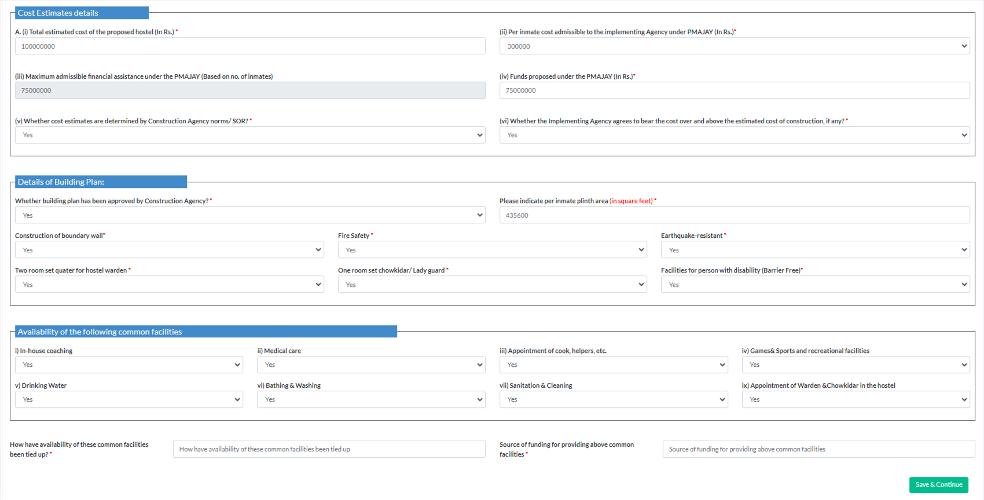
Continued…
Format to submit the proposal of New hostel Part 1

Slide 29
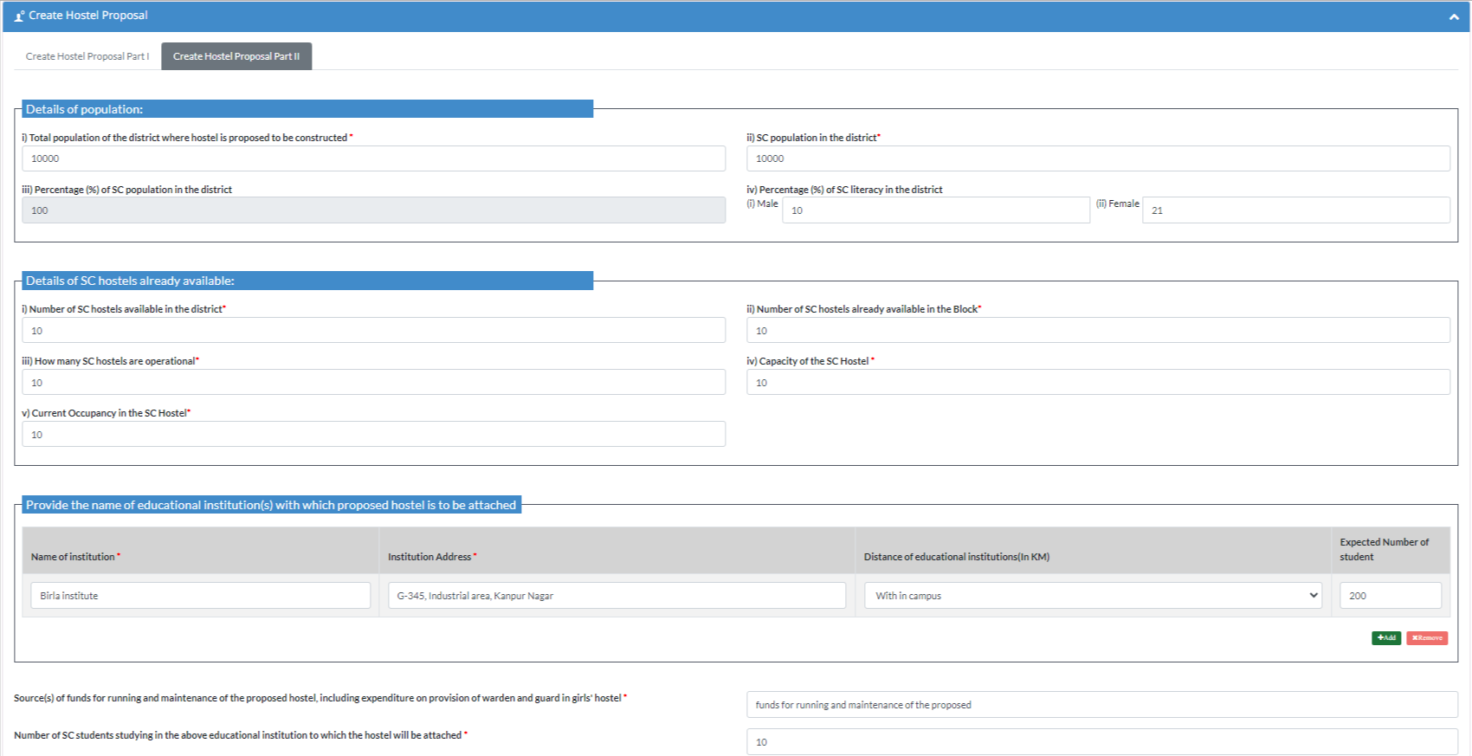
Continued…
Format to submit the proposal of New hostel Part 2

Slide 30
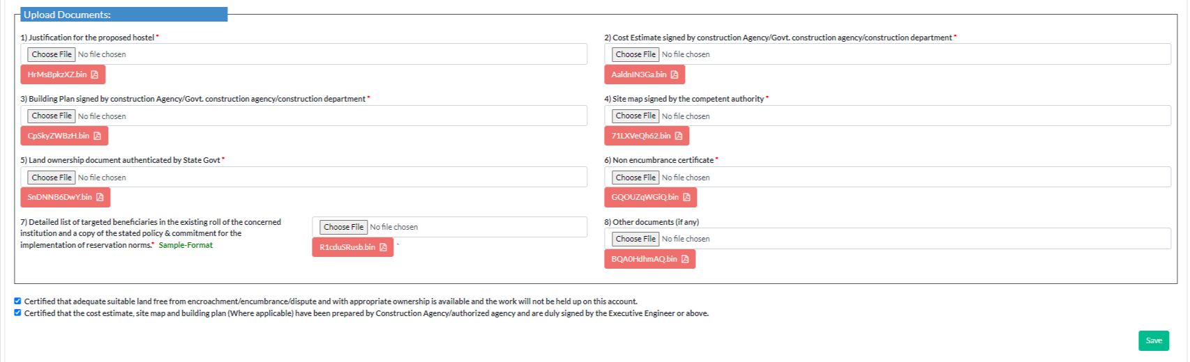
Continued…
Format to submit the proposal of New hostel Part 2

Slide 31
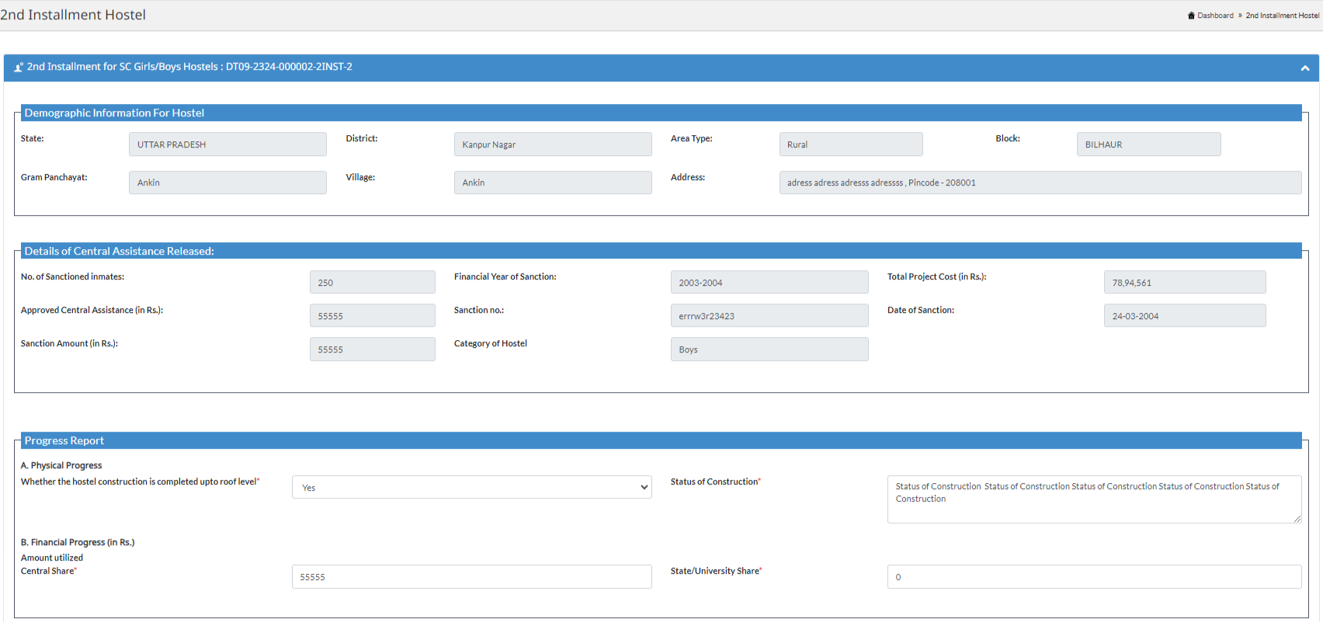
Format to submit the proposal of
2nd Instalment hostel

Slide 32
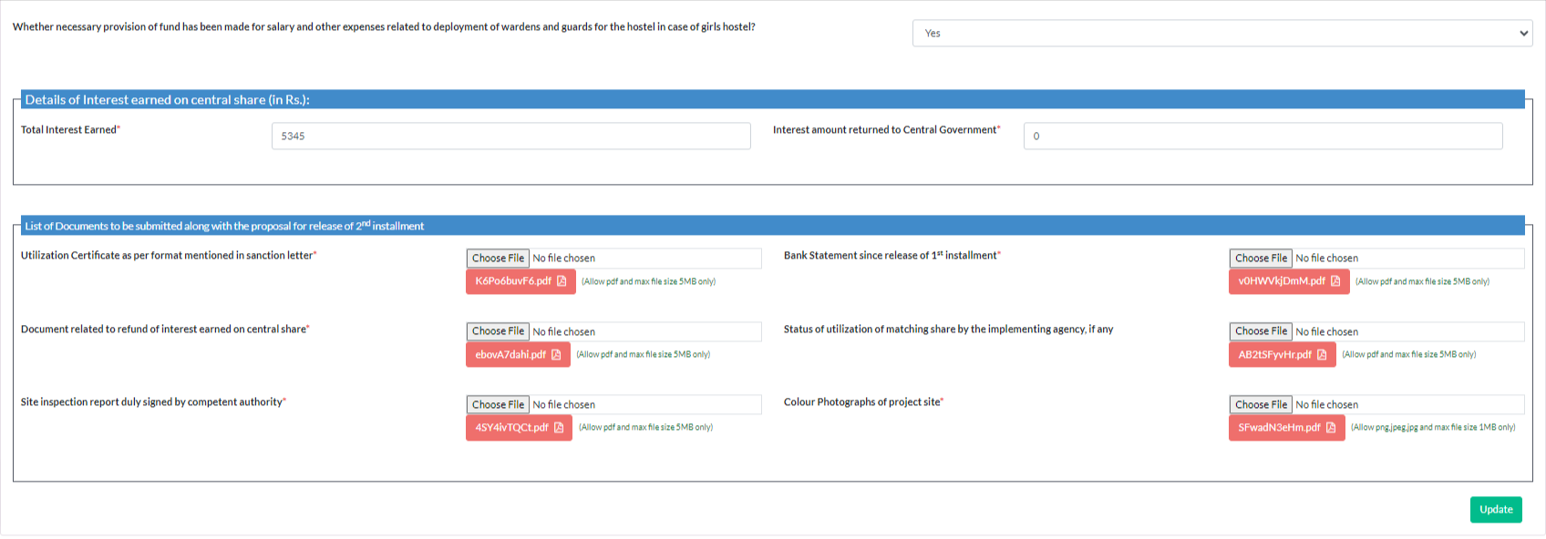
Continued…
Format to submit the proposal of
2nd Instalment hostel

Slide 33
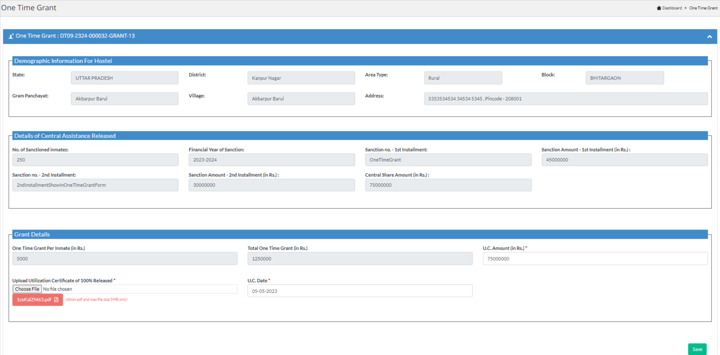
Format to submit the proposal of
One Time Grant

Slide 34
Format to submit the proposal of Expansion hostel Part 1

Slide 35
Continued…
Format to submit the proposal of Expansion hostel Part 1

Slide 36
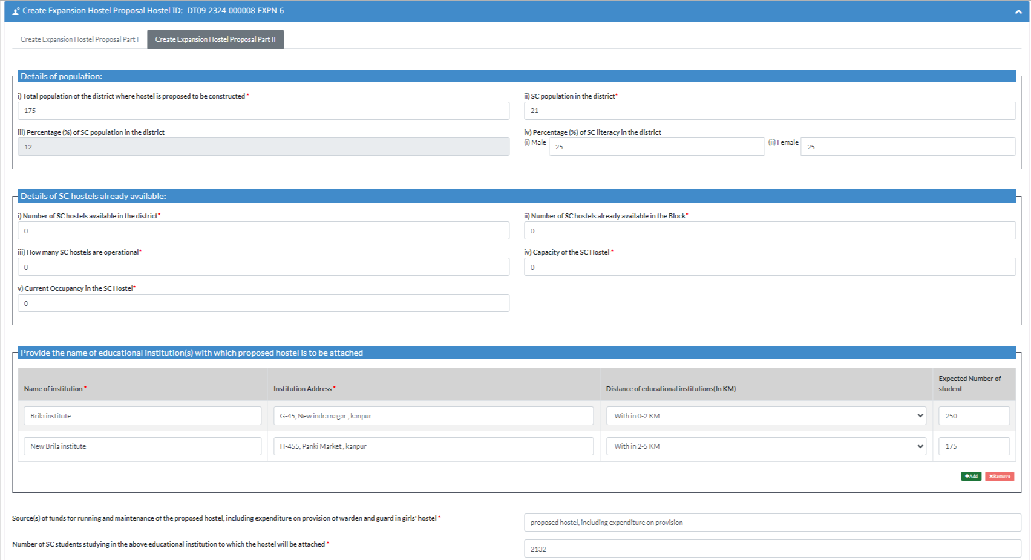
Continued…
Format to submit the proposal of Expansion hostel Part 2

Slide 37
Continued…
Format to submit the proposal of Expansion hostel Part 2

Slide 38
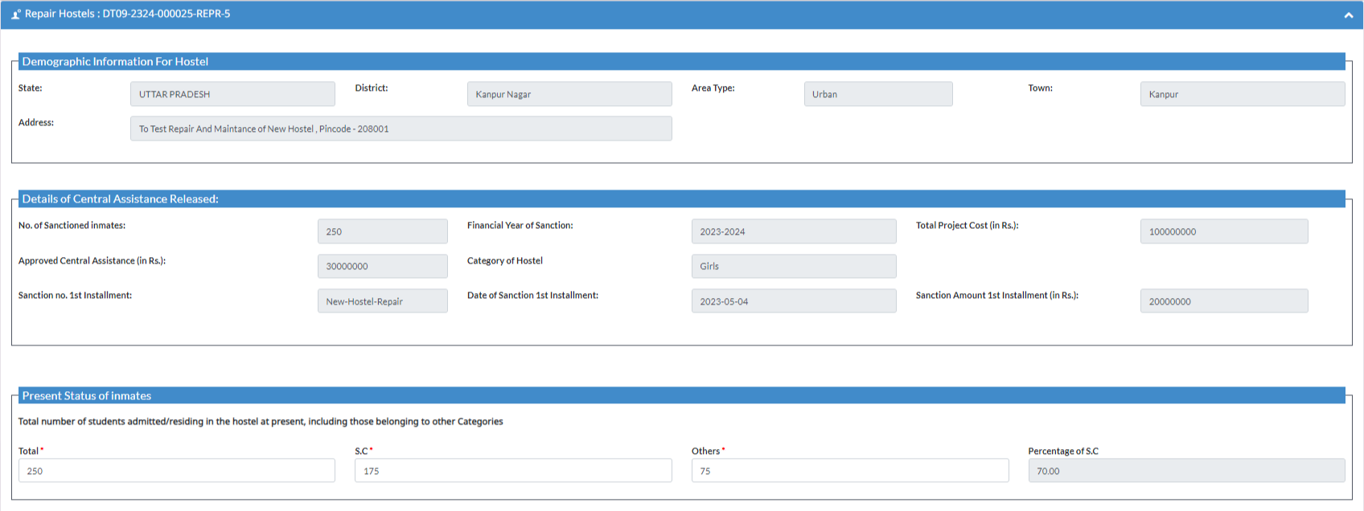
Format to submit the proposal of
Repair and Maintenance of hostel

Slide 39
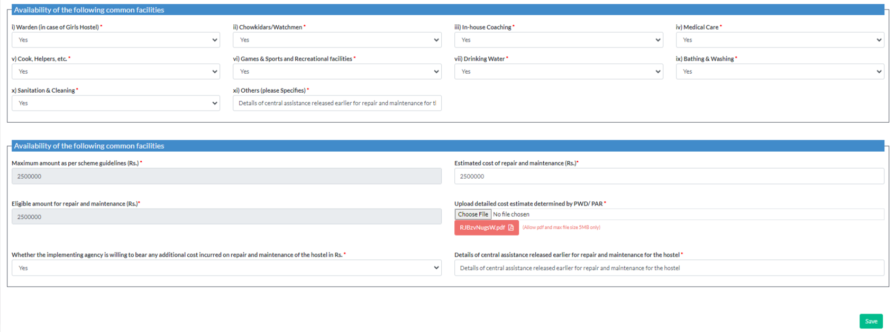
Continued…
Format to submit the proposal of
Repair and Maintenance of hostel

Slide 40
Online Submission of Hostel Proposals in 2022-23
States/Institute/University Submitted Hostel Proposals
No. of Proposals Submitted
No. of Proposals Approved Online
5
12
8

Slide 41
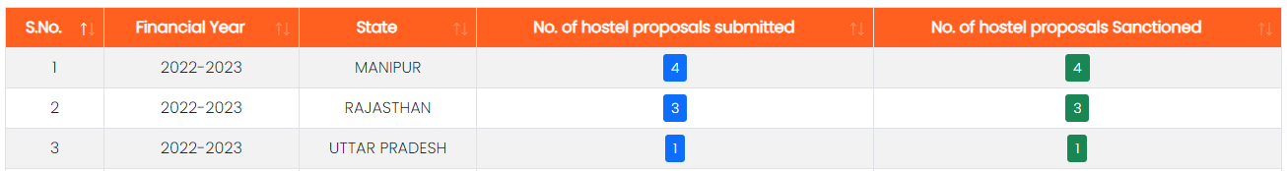
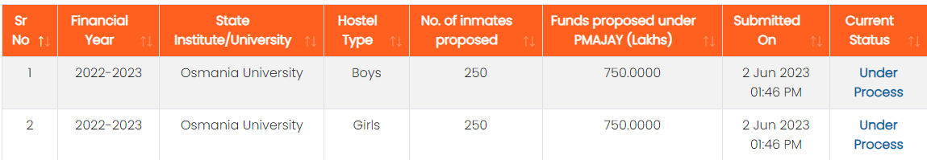
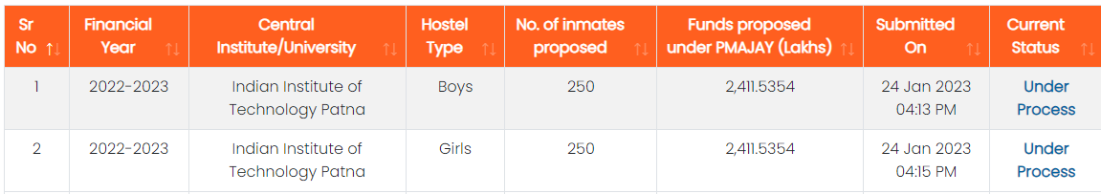
Online Submission of Hostel Proposals in 2022-23
State/
District
State
Level
Institute
Central
Level
Institute

Slide 42

THANK
You
You can contact us at:
011-23070579
support.pmagy-msje@gov.in

